Slide 1


Slide 2

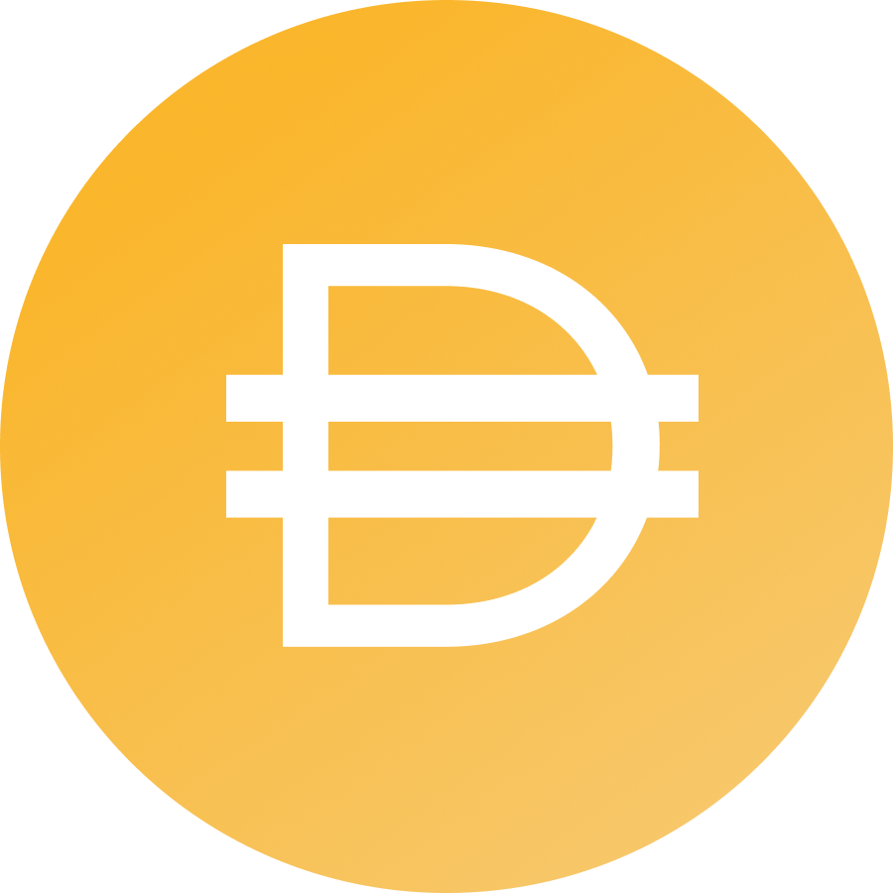
What is MakerDAO?

Slide 3
Open Platform For Stability & Credit

Slide 4
1 DAI = $1

Slide 5
Why Do We Need a Stablecoin?

Slide 6
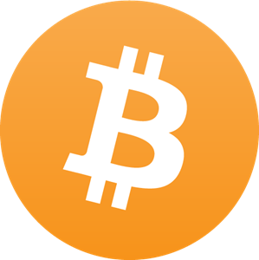
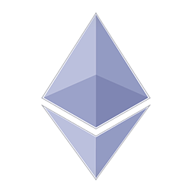
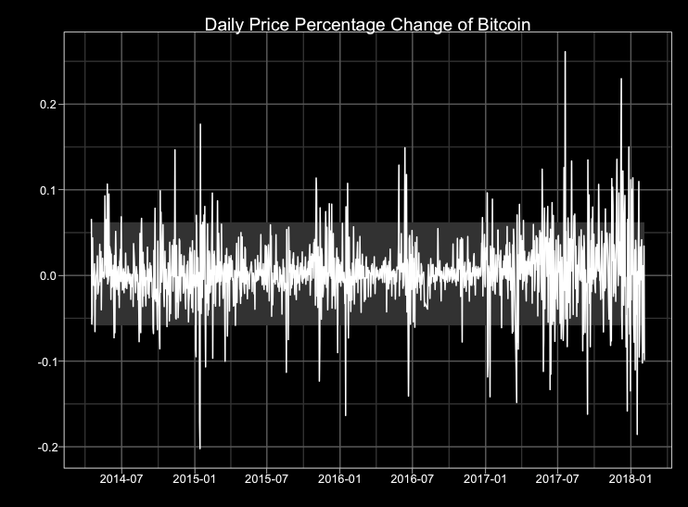
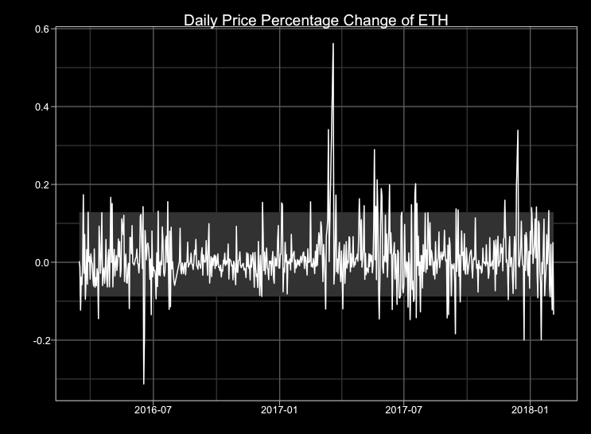
Bitcoin and Ethereum?

Slide 7
A Stable Medium of Exchange

Slide 8
How Does Dai Work?

Slide 9
Imagine the gold standard but with any asset

Slide 10


Two Types of Users
Stability Seekers (basic)
vs
Risk Seekers (advanced)

Slide 11
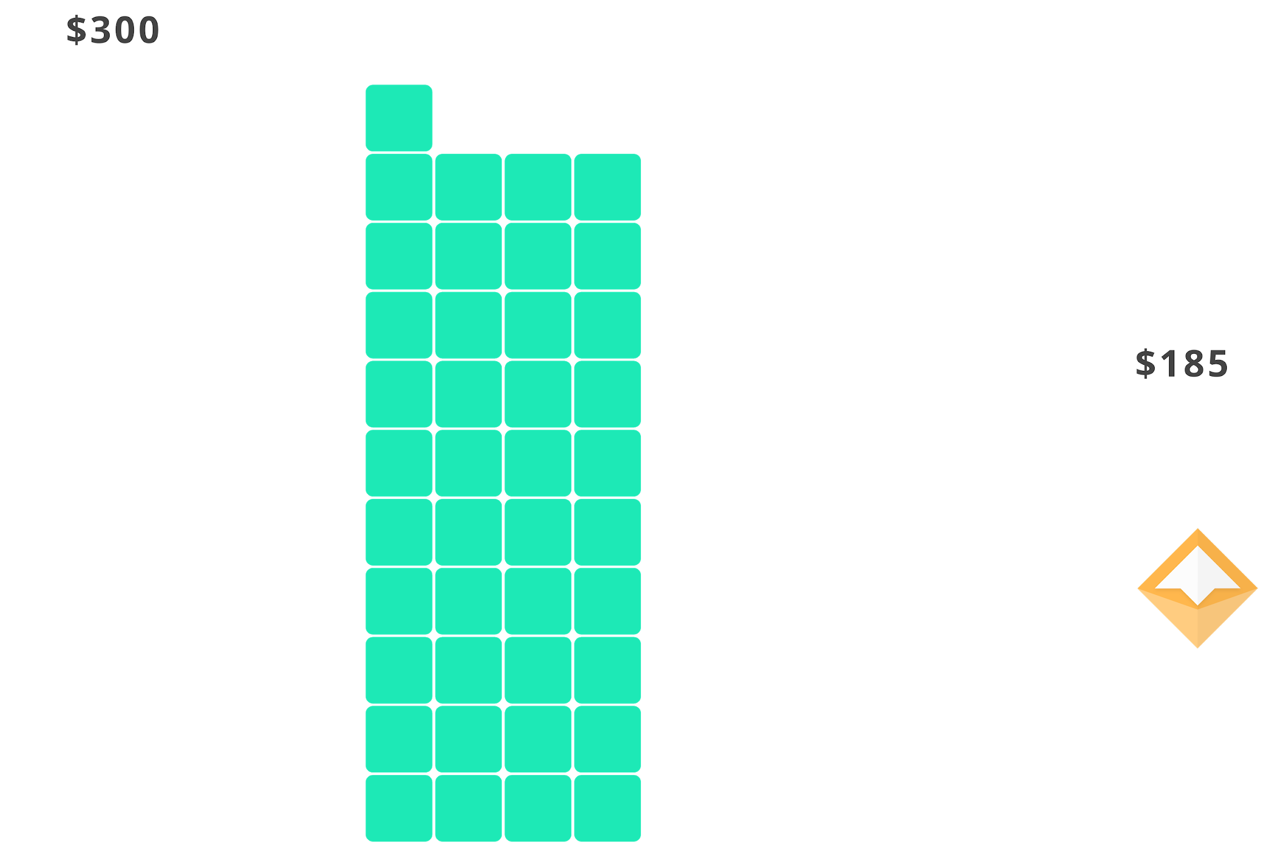
Vault
Borrow Dai through locking up collateral
Repay Dai + fee to retrieve collateral

Slide 12
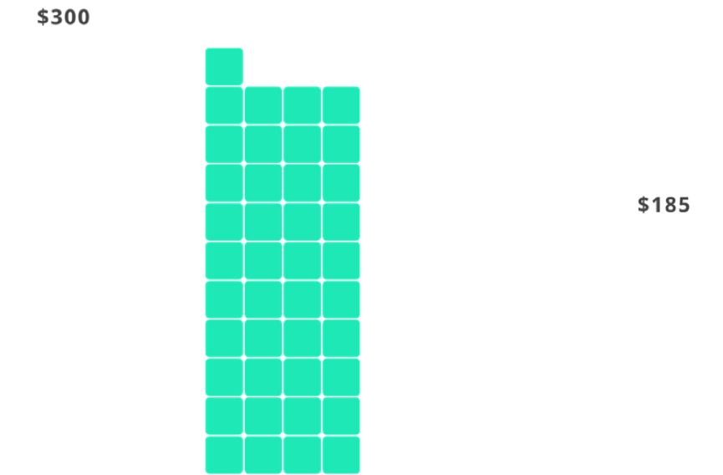

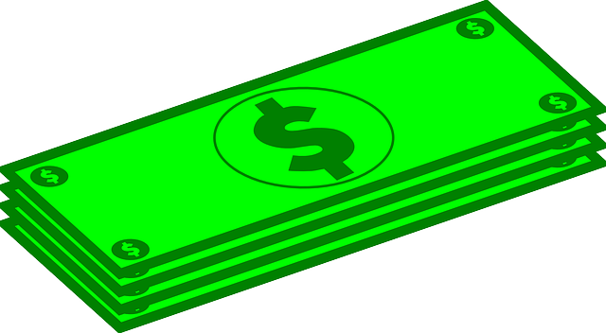
Analogous To A Mortgage
Borrow money with a mortgage from the bank
Repay debt + interest to “retrieve” the house

Slide 13
Open Decentralized Credit System

Slide 14


Decentralized Margin Trading
CDP
ETH
DAI

Slide 15
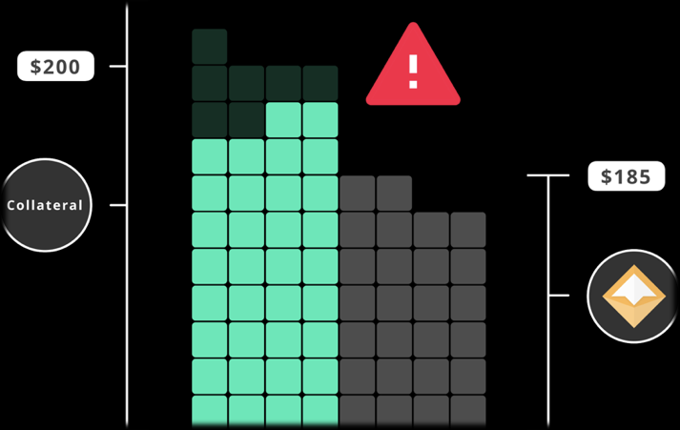
Liquidations
Vault is liquidated if the collateral value falls too low
Collateral is auctioned off until debt is recovered
Vault owner receive the leftover collateral

Slide 16
How Does Dai Remain Stable?

Slide 17
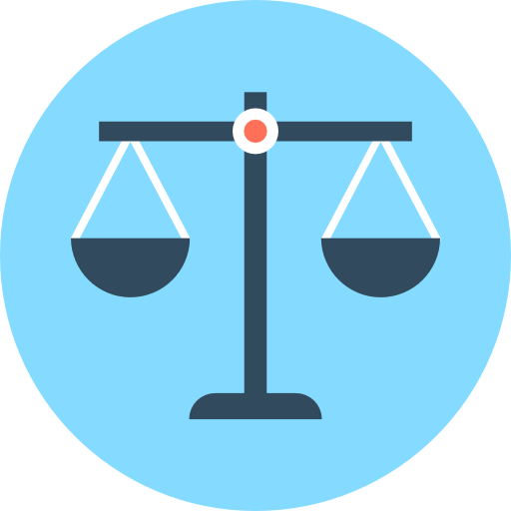
Ultimate Goal
Balance demand for creating and holding Dai

Slide 18
Stability Mechanisms
Supply Side
Demand Side
Diversification
Redeemability

Slide 19
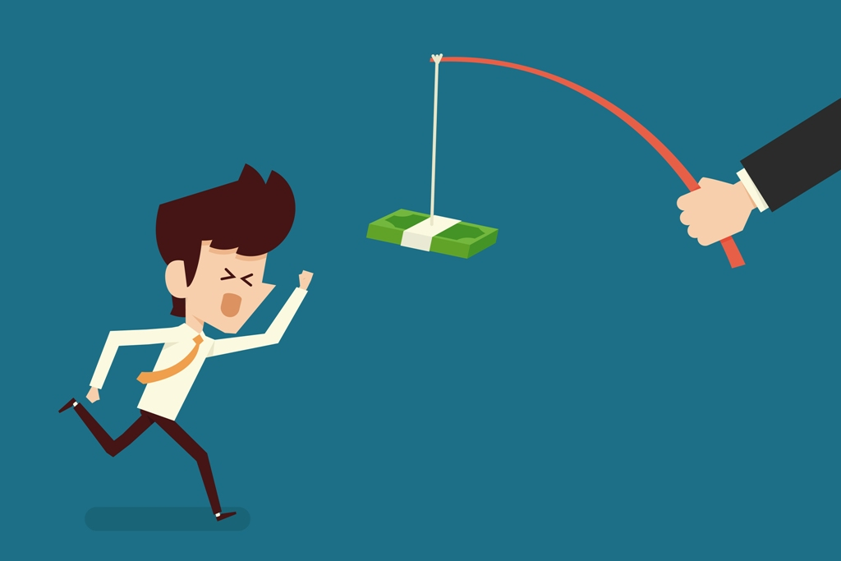
Supply Side
Incentivize supply expansion & contraction

Slide 20
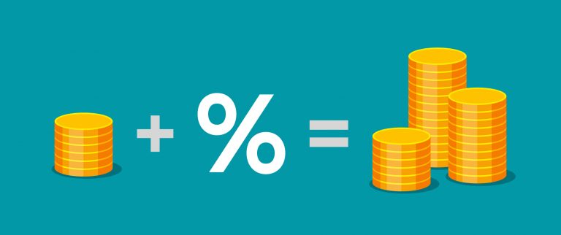
Demand Side
Dai Savings Rate

Slide 21
Dai Savings Rate
Regulates demand for holding Dai
A demand-side lever to complement the supply-side lever
Strengthens the peg
Increases utility of Dai
Enables new business models

Slide 22

Diversification
Diversified portfolio of non-correlated assets
Preferably highly liquid

Slide 23

Redeemability
Emergency Shutdown

Slide 24
Who Makes These Decisions?

Slide 25
Decentralized Governance

Slide 26

MKR
Manages risk
Earns Income
Finances bailouts
“Highest risk, highest reward”

Slide 27
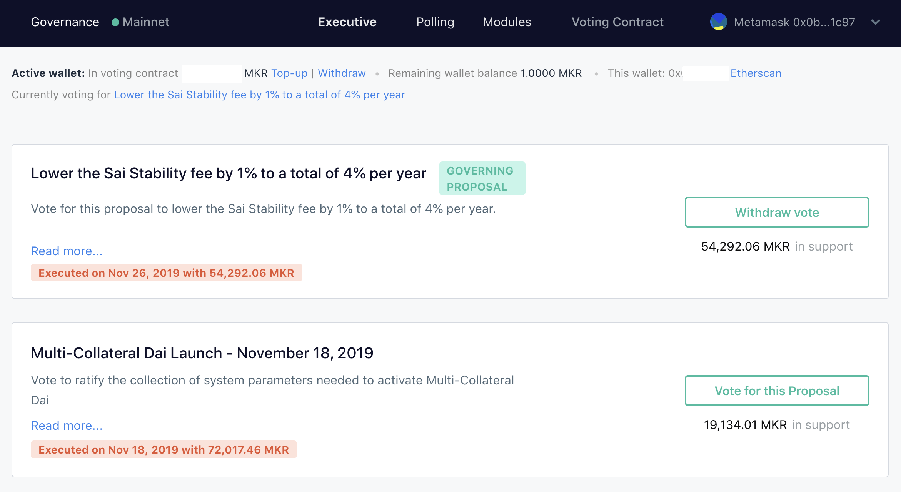

Slide 28
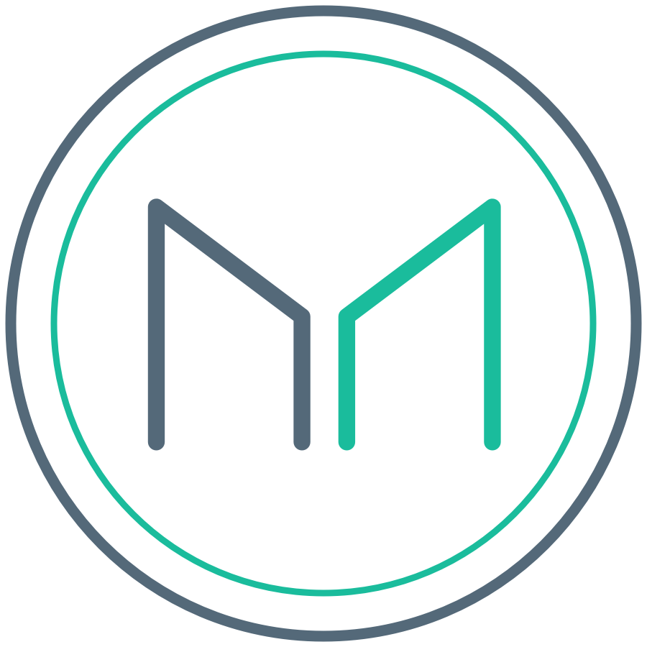
Simplified Diagram of the System
Second layer
guarantee
First layer
guarantee
Stability fee
Parameter Management
Vault

Slide 29
Where Are We Now?

Slide 30
Dai Is Live!

Slide 31
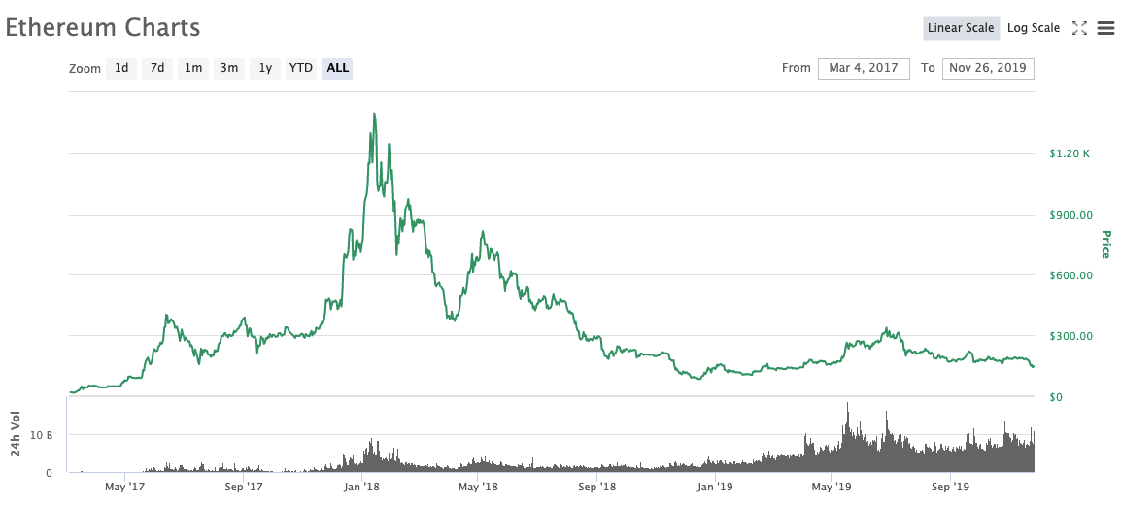

Slide 32
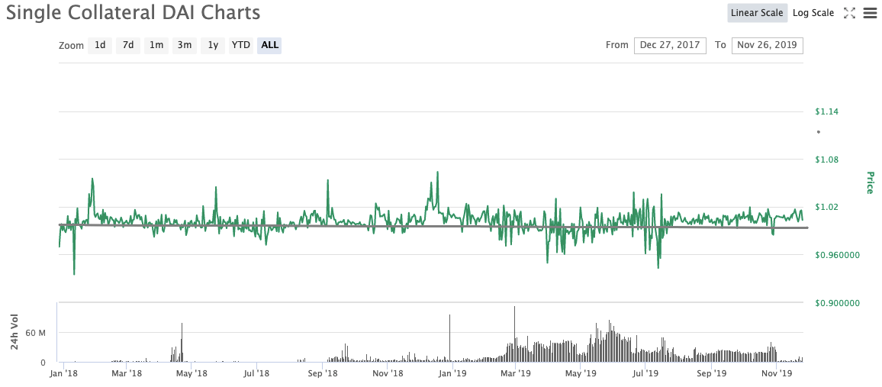

Slide 33
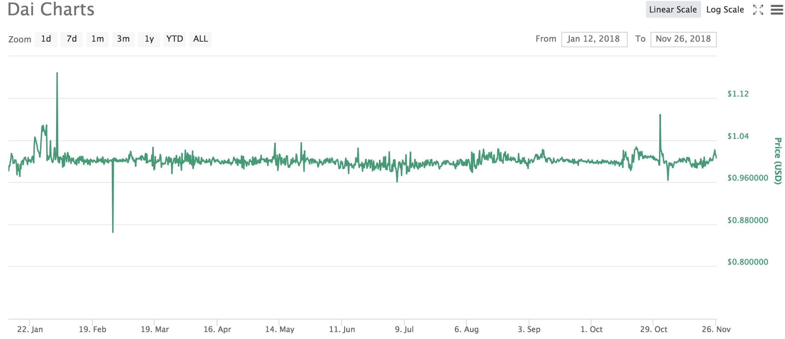

Slide 34
What is next?

Slide 35
Remittances
International remittances exceeded $600B in 2018
$440B sent to developing countries in 2018
Remittances to developing countries more than triple international aid
Global average cost is 8%
Up to 20% in Sub-Saharan African and Pacific Islands

Slide 36
Invoice Factoring
Invoices are effectively a way for large corporations to get interest free loans from suppliers
Businesses are highly reliant on cashflow
Allow businesses to access equity in their invoices
Global invoice factoring exceeded $3 Trillion in 2017
Partnering with Tradeshift to tokenize invoices to use as collateral for Dai.

Slide 37
Synthetic Assets
Once you have a proven mechanism for pegging a token to USD, you can replicate this to almost anything
Other fiat currencies, stocks, bonds, rare metals
Allows anyone in the world universal equal access to price exposure to any market

Slide 38




Join The Community
Website: makerdao.com
Reddit: /r/makerdao
Chat: chat.makerdao.com
Twitter: @MakerDAO
Forum: forum.makerdao.com

Slide 39
We’re Hiring!
makerdao.com/careers

Slide 40
Questions?

